Slide 1
Algebra 2 EOC Review April 7th

Slide 2
MAFS.912.A-REI.1.1 Explain each step Explain each step in solving a simple equation as following from the equality of numbers asserted at the previous step, starting from the assumption that the original equation has a solution. Construct a viable argument to justify a solution method.
.
Suppose x is a number such that .
Must it then be true that 3x = 12?
Explain your reasoning.
First solve for x.
2x + 6 = - 6 + 6
(2x + 6) • 2 = • 2
4x +12 – 4x = x – 4x
12/-3 = -3x/ -3
-4 = x
So 3 (-4) = -12 then, 12 ≠ -12 it cannot be true.

Slide 3
Solve the equation
Explain and justify each step in your solution process.
• 4 = 7 • 4 multiply each side by 4 Multiplication property of equality
5x + 3 – 3 = 28 – 3 Subtract 3 from each side
Subtraction property of Equality
5x / 5 = 25 / 5 divide each side by 5
Division Property of equality
X = 5

Slide 4
You try it
Show that x = 2 and x= -3 are solutions to the equation X² + x = 6
X² + x – 6 = 6 – 6 subtract 6 from each side
(x + 3)(x -2) = 0 factor the trinomial
X = -3 x = 2 solve for x

Slide 5
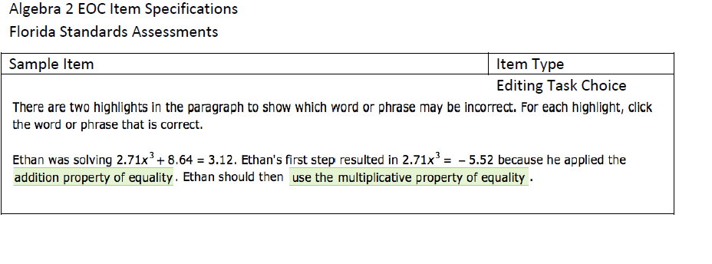
The addition property of equality; he added -8.64 to each side

Slide 6
MAFS.912.A-APR.1.1 -Understand that polynomials form a system analogous to the integers, namely, they are closed under the operations of addition, subtraction, and multiplication; add, subtract, and multiply polynomials.
Which expression is equivalent to the expression below?
a²x² – 2cx² + a²y – 2cy
A. (x² – y)(a² – 2c)
B. (x² – y)(a + c)
C. (x² + y)(a² – 2c)
D. (x² + y)(a + c)
Factoring by grouping:
X²(a² – 2c) + y(a² – 2c)
(x² + y)(a² – 2c)

Slide 7
In each problem perform the indicated operation and write your answer in standard form.
(2x + 1)(x – 5)
2x² – 9x – 5
(2t³ + 3t – 4) – (4t² – 6t)
2t³ – 4t² + 9t – 4
(x² – 1) + (x + 1)
X² + x
When you add or subtract two polynomials will the result always be a polynomial? Yes, real numbers are closed under addition and subtraction
When you multiply or divide two polynomials will the result always be a polynomial? Multiply yes, since real numbers are closed under multiplication; divide No

Slide 8
You try it
Simplify:
Factor the numerator
= (a – b)

Slide 9
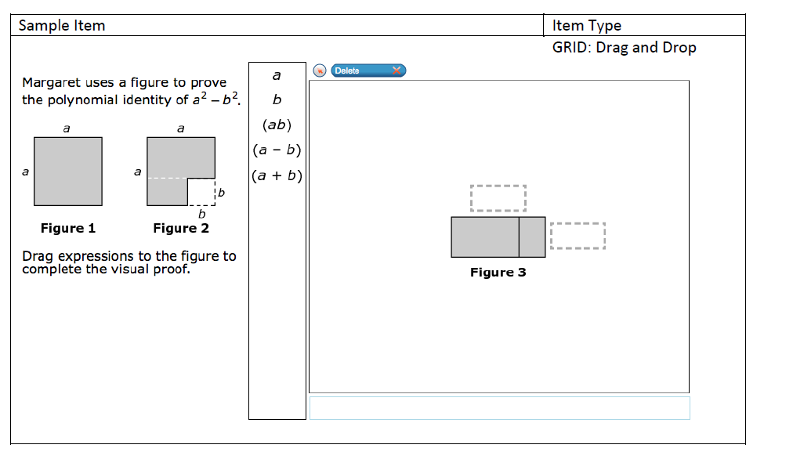
(a + b)
(a – b)

Slide 10
MAFS.912.A-APR.4.6 Rewrite simple rational expressions in different forms; write a(x)/b(x) in the form q(x) + r(x)/b(x), where a(x), b(x), q(x), and r(x) are polynomials with the degree of r(x) less than the degree of b(x), using inspection, long division, or, for the more complicated examples, a computer algebra system.
Divide (x³ + 3x² + 25) ÷ (x + 5)
Use long or synthetic division to solve
1 3 0 25
-5 -5 10 -50
1 -2 10 -25
So the correct answer is X² -2x + 10 -

Slide 11
You try it
Is (x + 1) a factor of (2x³ -3x² + 7x + 12) ?
How do you know?
(2(-1³) -3(-1²) + 7(-1) + 12)
(-2 – 3 – 7 + 12) = 0
Yes. Use the Remainder Theorem and substitute (-1) for x in the polynomial and the result is the remainder. If the remainder is 0 then (x + 1) is a factor of the polynomial.

Slide 12
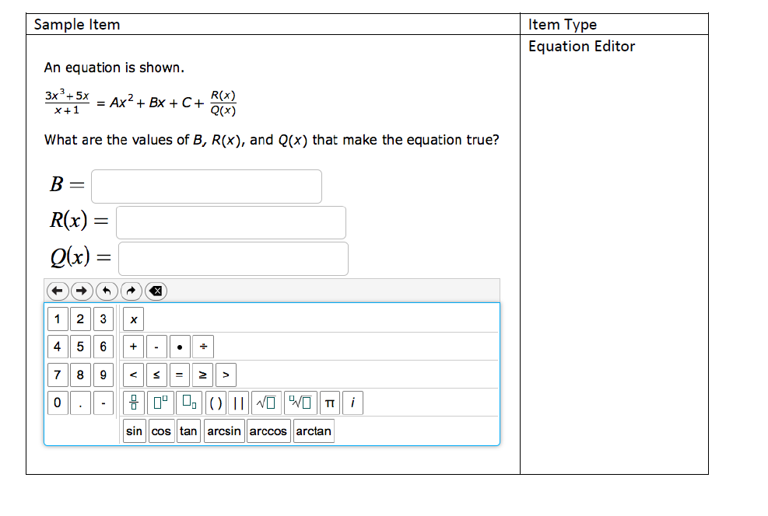
3x² – 3x + 8
x + 1
3x³ + 0x² + 5x
-(3x³ + 3x²)
- 3x² + 5x
-3
-(-3x² – 3x)
-8
(8x + 0)
X + 1
- (8x + 8)
- 8

