Slide 1
MAFS.912.F-1.2
Write arithmetic and geometric sequences both recursively and with an explicit formula, use them to model situations, and translate between the two forms. ★

Slide 2
MAFS.912.F-1.2
Arithmetic
Example 1: Use the formula A_{n} = A₁ + d(n-1) where d is the common difference to generate a sequence whose first three terms are : -7, -4, and -1.
Subtract to find d
-4- (-7) = 3 -1 - (-4) = 3
D = 3
Plug in first term and d
A_{n} = -7 + 3(n-1)

Slide 3
MAFS.912.F-1.2
You try: What is the 9th term in the sequence 3, 5, 7, 9…?
Step 1: Find d 5-3, 7-5, 9-7 = 2; d = 2
Step 2: Write the explicit formula:
A_{n} = 3 + 2(n-1)
Step 3: Plug in 9 for n:
3+2(9-1) = 3 + 2(8) = 3 + 16 = 19

Slide 4
Geometric
Example 1: There are 2,500 fish in a pond. Each year the population decreases by 25%. Find the population after 5 years.
Step 1: Write an explicit formula:
A_{n} = a₁ ∙ r^{n-1}
Step 2: Determine the ratio – If the decrease is .25, then the ratio is .75 because 75% will be left.
Step 3: Plug in known information:
A₅ = 2500 (.75⁵) = 593.26, or about 593 fish
Hint: n-1 is 5 in this case because we are finding an amount after 5 years, and the initial amount is also a term. There are 6 total terms.

Slide 5
Example 2: Write a sequence given r = 2 and a₁ = 3
Write a formula A_{n} = a₁ ∙ r^{n-1}
Plug in values A_{n} = 3∙2^{n-1}

Slide 6
You try: One term in a sequence is a₂ = 15. The ratio is 3. Write a rule to find the nth term of the sequence.
A_{n} = a₁ ∙ 3^{n-1}
15 = a₁ ∙ 3²⁻¹
15 = a₁ ∙ 3
15÷3 = a₁
5 = a₁
A_{n} = 5 ∙ 3^{n-1}

Slide 8
What are we trying to find?
The amount of oil over a period of time.
How is it determined?
Total oil less oil removed by skimmer (subtraction)
The radius is 4.03t^{0.5} and can be plugged into the area function
A(r) = 0.52 ∏ (4.03t^{0.5})²
Calculate radius squared: 4.03² t^{0.5(2)} = 16.241t
A(r) = 26.53t
Subtract removed oil: 26.53t – (6.73t^{0.5} + 0.23t²)
Solution: -0.23t² + 26.53t – 6.73t^{0.5}

Slide 9
MAFS.912.F-BF.2.3
Identify the effect on the graph of replacing f(x) by f(x) + k, k f(x), f(kx), and f(x + k) for specific values of k (both positive and negative); find the value of k given the graphs. Experiment with cases and illustrate an explanation of the effects on the graph using technology. Include recognizing even and odd functions from their graphs and algebraic expressions for them.

Slide 10
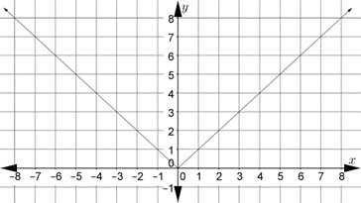
Example 1:
The following is a graph of y = | x |

Slide 11
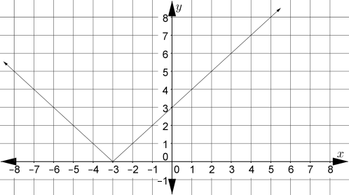
Write the equation of each of the graphs below:
1.
y = | x + 3 |

Slide 12
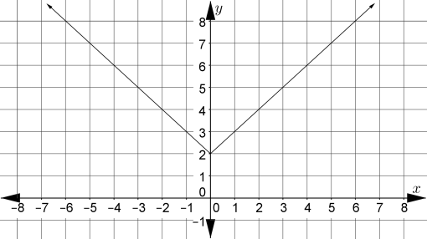
2.
y = | x | + 2

Slide 13
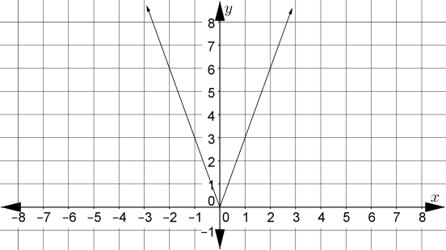
3.
y = 3|x| or |3x|

Slide 14
Questions:
In general, what is the effect of the value of c on the graph of the function f(x) = $b^{x}$ + c?
c will translate the graph up or down
In general, what is the effect of the value of b on the graph of the function f(x) = $b^{x}$ + c?
b is the growth factor. If it is greater than 1, it is exponential growth; if it is between 0 and 1, it is a rate of decay and the graph is decreasing to the right.

Slide 15
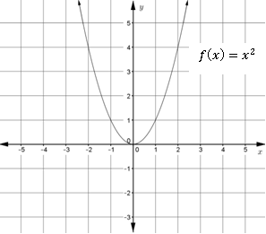
You try:
The graph of f(x) = x² is shown:

Slide 16
Describe how each of the following functions compares to the graph of the function f.
$g\left(x\right)=({x+3)}^{2 }−2$
$h\left(x\right)=({x−4)}^{2 }+6$
$j\left(x\right)= 2x^{2}$
$k\left(x\right)= \frac{1}{2}x^{2}$
$m\left(x\right)= −x^{2}$

Slide 17
1. Shift left 3 units and down 2 units
2. Shift right 4 units and up 6 units
3. Stretch vertically by a factor of 2 – the graph increases twice as fast as f(x)
4. Compress by a factor of ½ - the graph increases half as fast as f(x)
5. Reflect the graph over the x axis.

Slide 18
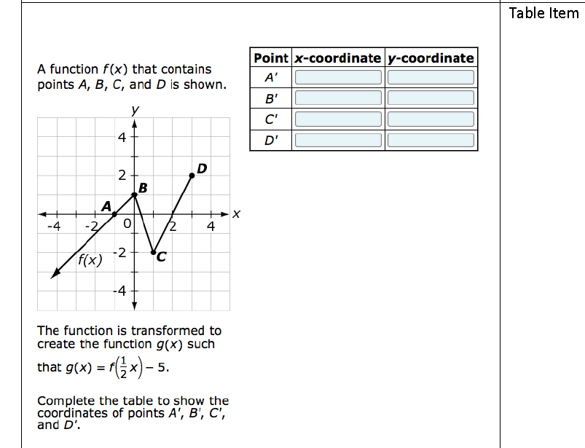
Test sample:

Slide 19
Step 1: Find the new values for f($\frac{1}{2}$x)
If 1/2x is the original, what are the new x values?
½ x₁ = x₀
($\frac{2}{1}$)$\frac{1}{2}$x₁ = ($\frac{2}{1}$) x₀
x = 2x

Slide 20
Original points: (-1,0) New points: (-2,0)
(0,1) (0,1)
(1,-2) (2,-2)
(3,2) (6,2)

Slide 21
Next, shift the graph down 5 units, or compute y – 5 for each y value:
Final points: A’ (-2,-5)
B’ (0,-4)
C’ (2,-7)
D’ (6,-3)

Slide 22
-2 -5
0 -4
-7
6 -3

Slide 23
MAFS.912.F-BF.2.4
Find inverse functions.
Solve an equation of the form f(x) = c for a simple function f that has an inverse and write an expression for the inverse. For example, f(x) =2 x³ or f(x) = (x+1)/(x–1) for x ≠ 1.
Verify by composition that one function is the inverse of another.
Read values of an inverse function from a graph or a table, given that the function has an inverse.
Produce an invertible function from a non-invertible function by restricting the domain.

Slide 24
Understanding inverses: Input and output values trade places, as well as the domain and range. For example, f(Ohio) = Columbus would have the following inverse: f⁻¹(Columbus) = Ohio
Example 1: f(x) = 2x + 5 Find the inverse.
Step 1: x and y trade places x = 2y + 5
Step 2: Solve for y x-5 = 2y + 5 – 5
x – 5 = 2y
$\frac{x−5}{2}$ = y
or ½ x – 2.5 = y

Slide 25
You try:
Example 2: f(x) = x² + 5
Find the inverse and determine if it is a function.
x = y² + 5
x - 5 = y² + 5 – 5
x - 5 = y²
$±\sqrt{x−5}$ = y

Slide 26
The original graph is a parabola shifted up 5 units. It passes the vertical line test and is a function. The inverse is NOT a function. When you choose points from the original graph and trade places with the x and y coordinates, the new graph is a parabola turned sideways. It does not pass the vertical line test, therefore the inverse does not exist.

Slide 27
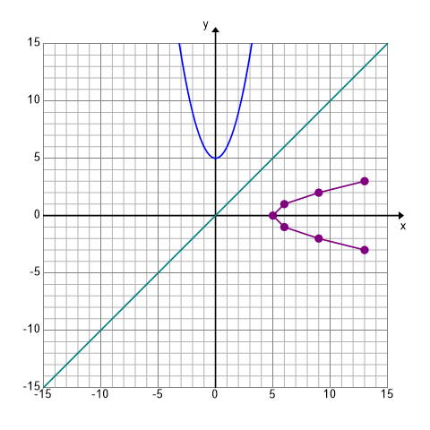

Slide 28
Example 3: Show by composition that f(x) and f⁻¹(x) are inverse functions.
f(x) = - $\frac{2}{3}x$+ 7
f⁻¹(x) = x = - $\frac{2}{3}$y + 7
x – 7 = -$\frac{2}{3}$y
(-$\frac{3}{2}$)x – (-$\frac{3}{2}$)7 = y
-$\frac{3}{2}$x + $\frac{21}{2}$ = y
-$\frac{3}{2}$ x + 10.5 = y

Slide 29
(f ͦ f⁻¹)(-2) = (f ⁻¹ ͦ f)(-2) =
(f ͦ f-1)(-2) = (f -1 ͦ f)(-2) =
f(f-1(-2)) = f(-3/2x + 10.5) f-1(f(-2)) = f-1(-2/3(-2) + 7)
= f(-3/2(-2) + 10.5) = f-1(4/3 + 7)
= f(3+10.5) = f-1 (25/3)
= f(13.5) = -3/2(25/3) + 10.5
= -2/3(13.5) + 7 = -12.5 + 10.5
= -2 = -2
Because the compositions are both equal to the x value that was tested, they are inverses.

Slide 30
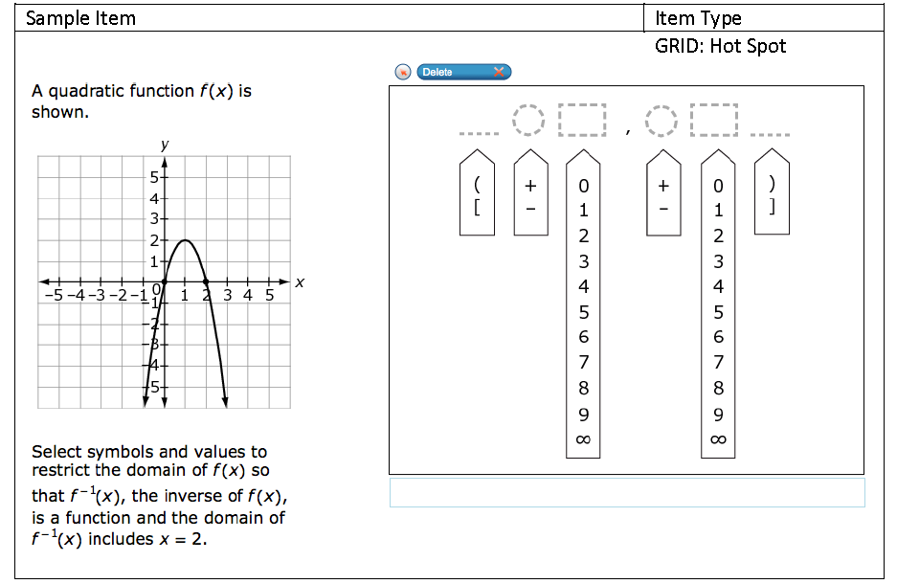
Test Sample:

Slide 31
First, find three coordinates of the original graph:
(0, 0), (1, 2), (2, 0)
Next, plot the inverse of these points:
(0, 0), (2, 1), (0, 2)

Slide 32
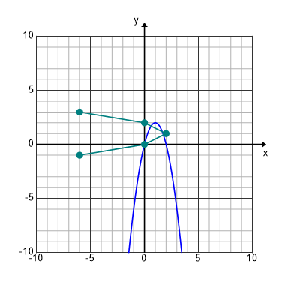
You can see that the inverse is not a function. In order to make it a function, only the top half or bottom half can be included. The domain has to be restricted (or limited) in a way that the graph of f⁻¹ is a function, and includes x = 2. The top half is used since it only has positive x values.

Slide 33
The original function contains the point (1, 2). The corresponding inverse point is (2, 1). Since we want this point to be included, the domain is restricted at the original x value: 1.
Show the domain in interval notation. $\left[+1,\right.\left.+∞\right)$
The bracket shows that the 1 is included, and the parenthesis shows that the graph keeps going toward infinity.

Slide 34
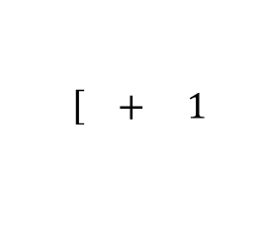
$$\left[ + 1 \right.$$
$$\left.+ ∞ \right)$$
+ ∞ )

